Slide 1
July 27, 2021
Shun-Nan W., Chu-Chun H., Sadiksha R.
ITCZ continues weakening. Dust arrives St. Croix. SAL continues moving westward.
Dust leaves St. Croix. AEW propagate westward. Dry and dusty air rolls into the west of AEW.
AEW continues propagating westward. Dry air intrudes deeper into the moist area.
New AEW propagates offshore from West Africa. African easterly jet is ahead of the inversed trough.

Slide 2
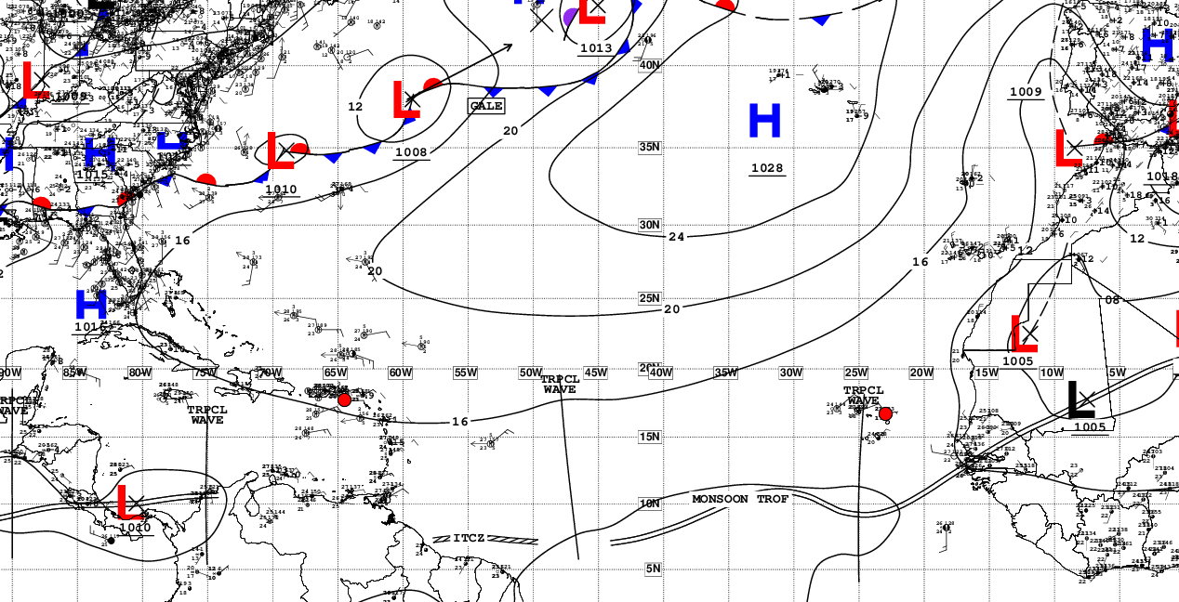
Current Conditions – Synoptic View
NHC Surface Analysis

Slide 3
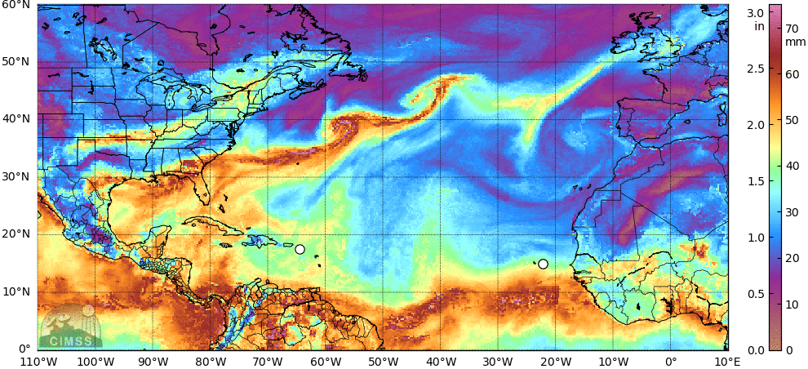
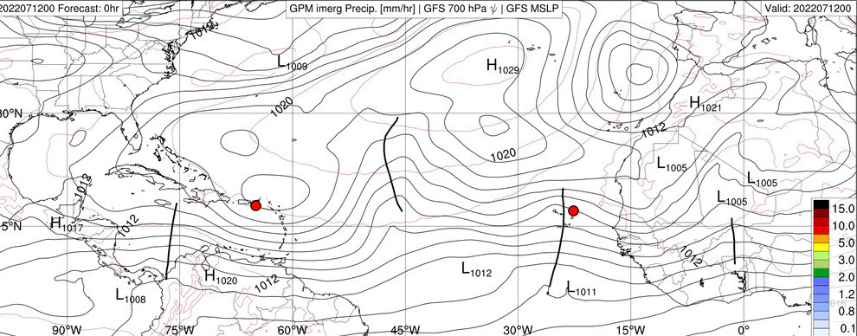
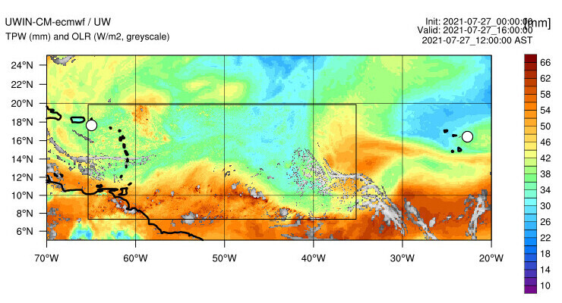
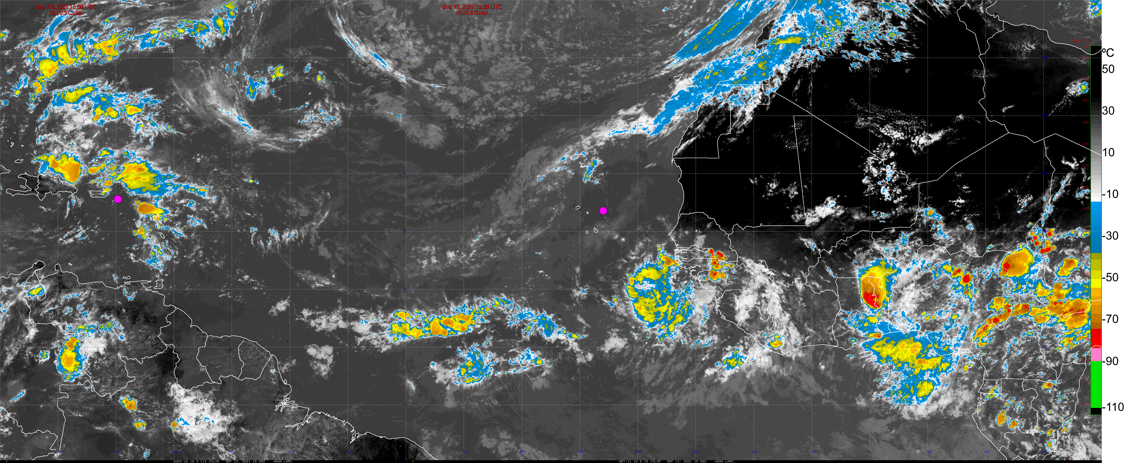
Current Conditions – ITCZ and AEW
Total Precipitable Water
IMERG Rain Rate, MSLP, Waves
Model OLR, TPW
GOES-16 / Meteosat-11 IR

Slide 4
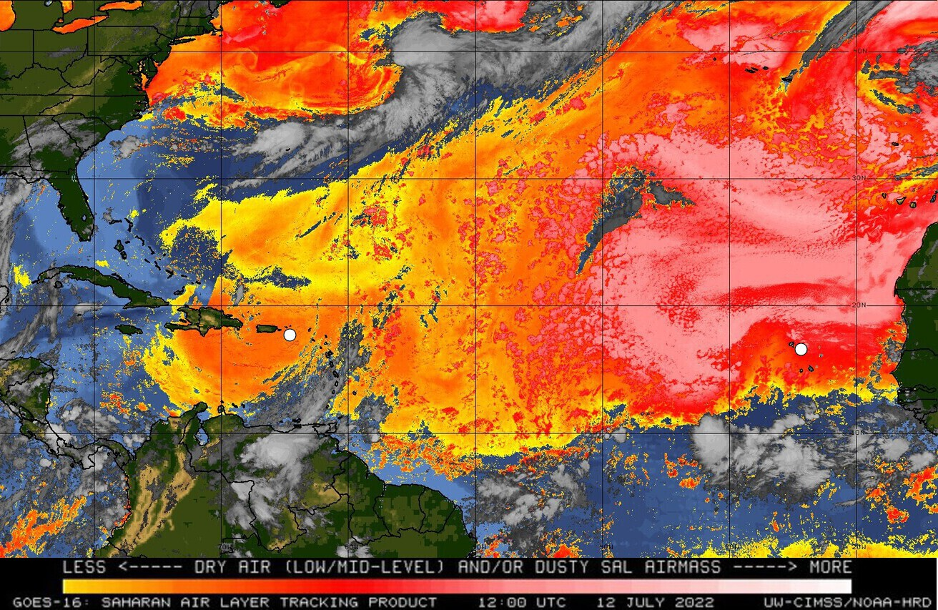
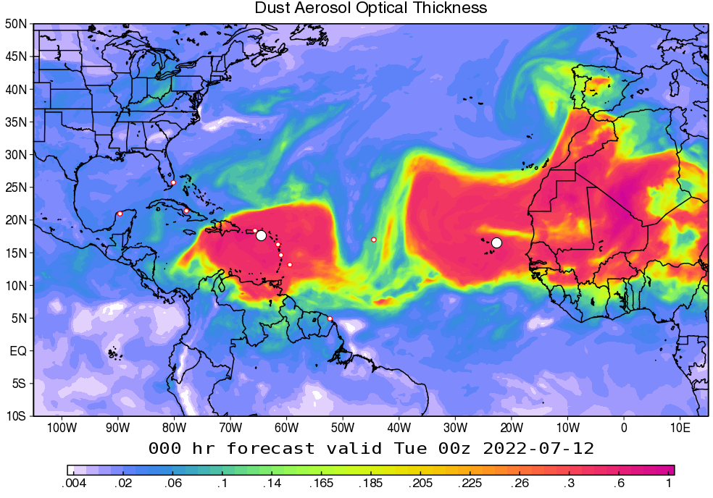
Current Conditions – Dust and Aerosols
SAL (split window)
Dust Aerosol Optical Thickness - GEOS

Slide 5
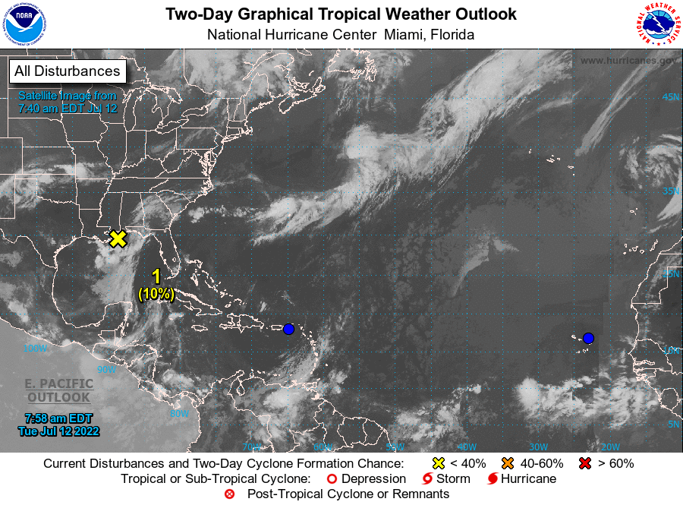
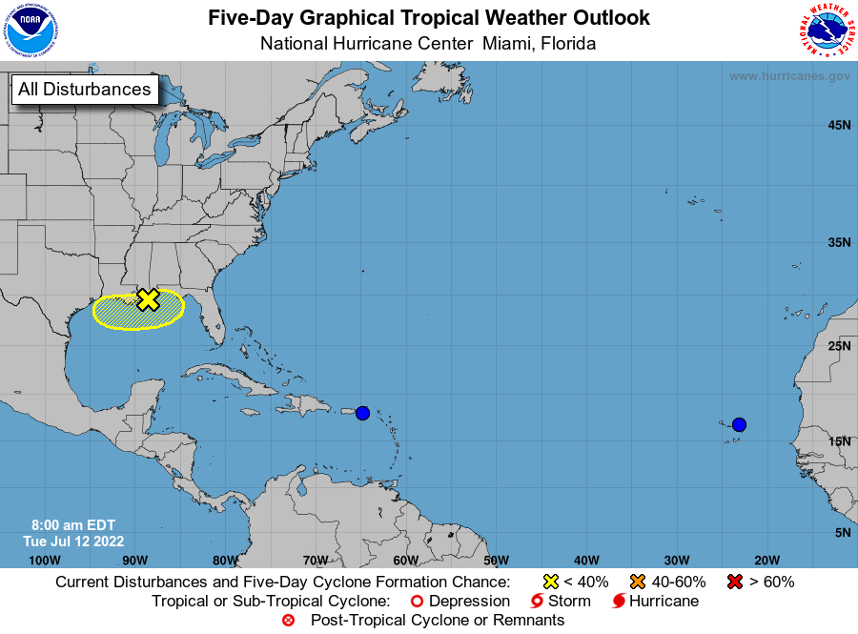
NHC Tropical Atlantic Outlook
(July 29 & Aug. 1, 2021)
2-day Outlook
5-day Outlook

Slide 6
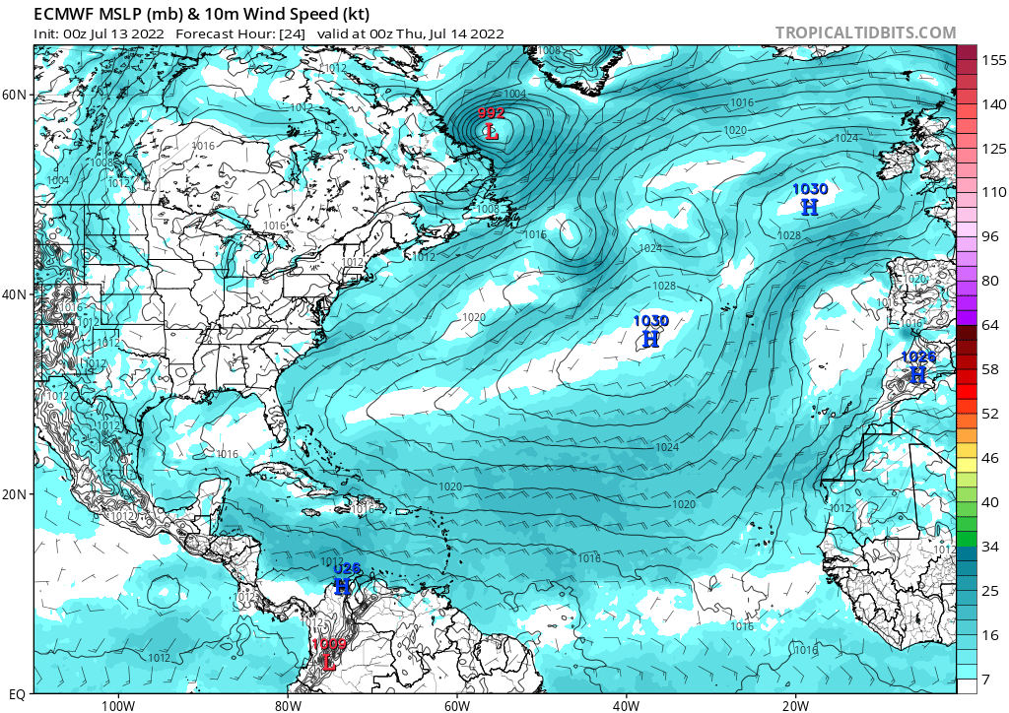
Forecast – day 1
(July 28, 2021)
10m Winds

Slide 7
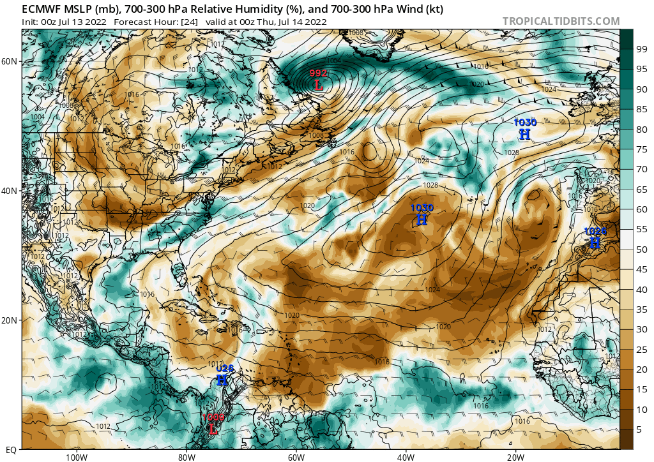
Forecast – day 1
(July 28, 2021)
Mid-level RH, Geopotential Height, Winds

Slide 8
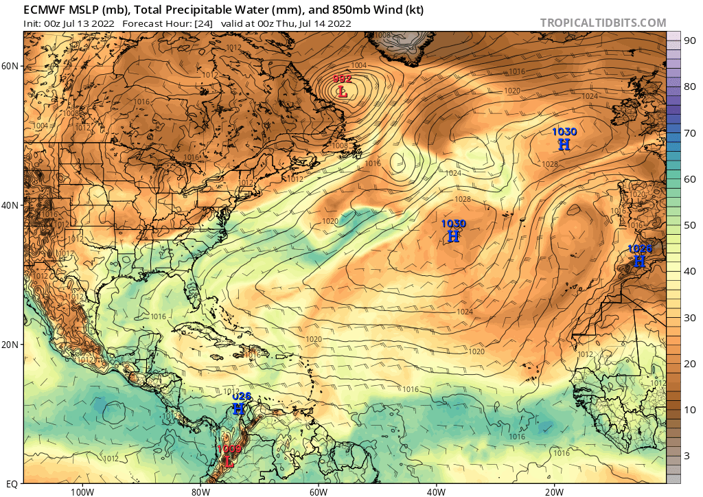
Forecast – day 1
(July 28, 2021)
TPW, OLR

Slide 9
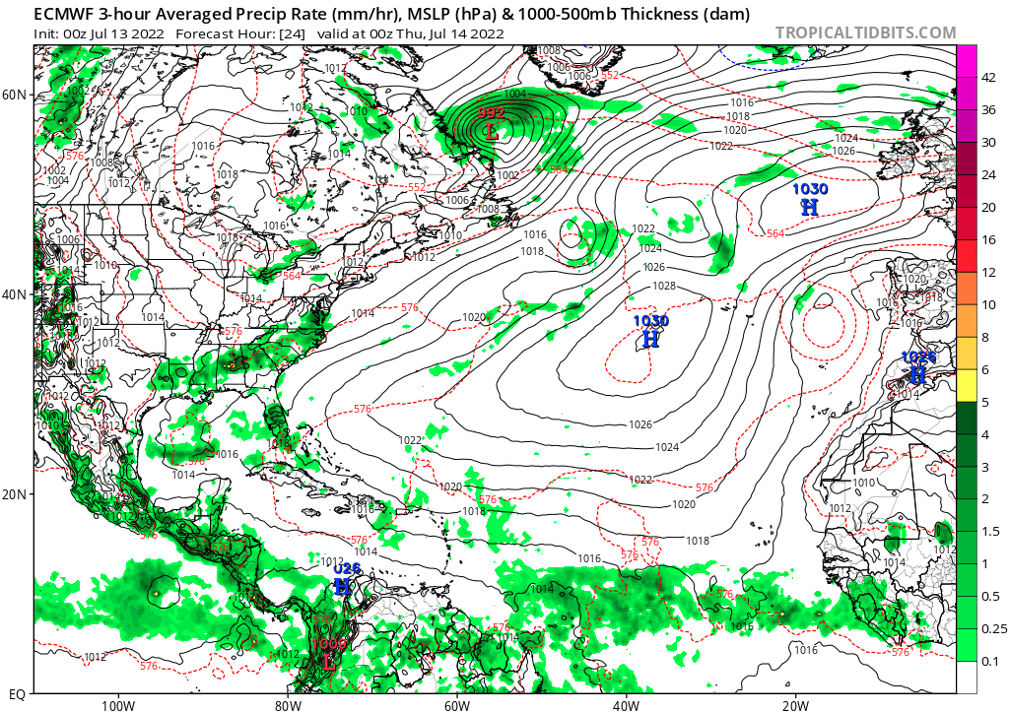
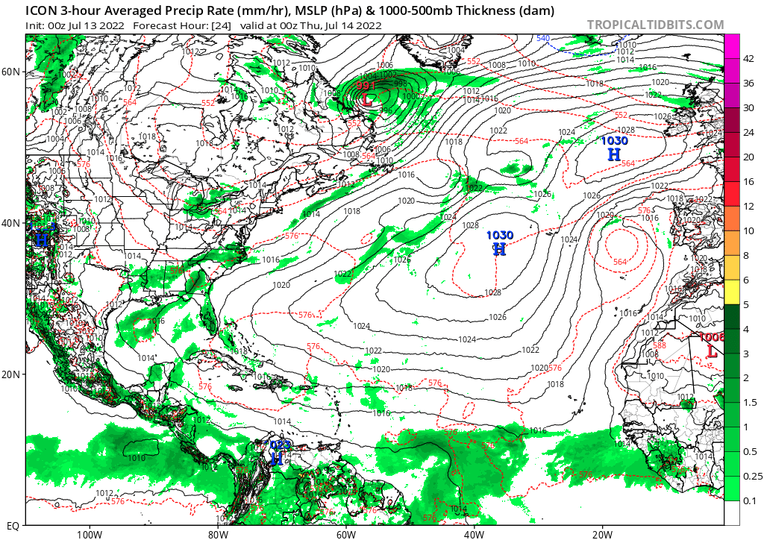
Forecast – day 1
(July 28, 2021)
10m Winds, Rain – ECMWF
10m Winds, Rain – ICON

Slide 10
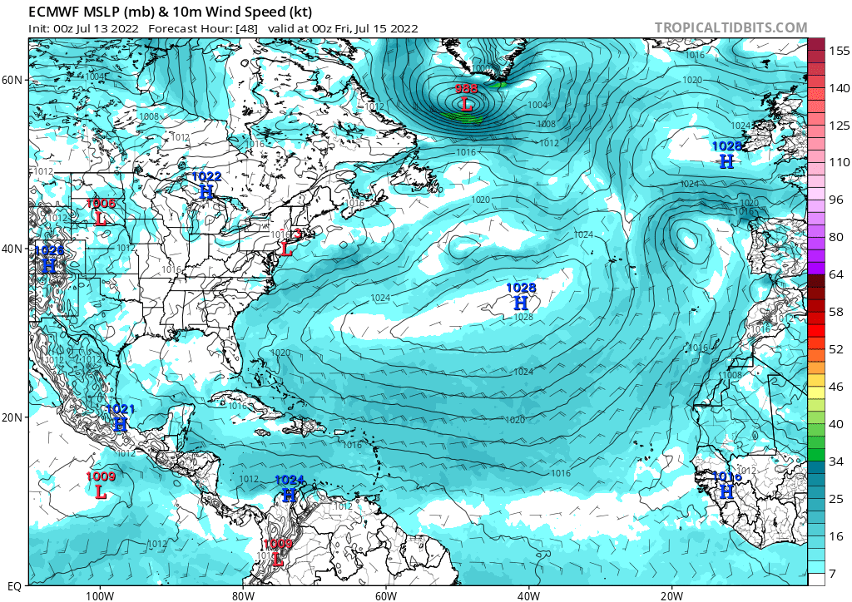
Forecast – day 2
(July 28, 2021)
10m Winds

Slide 11
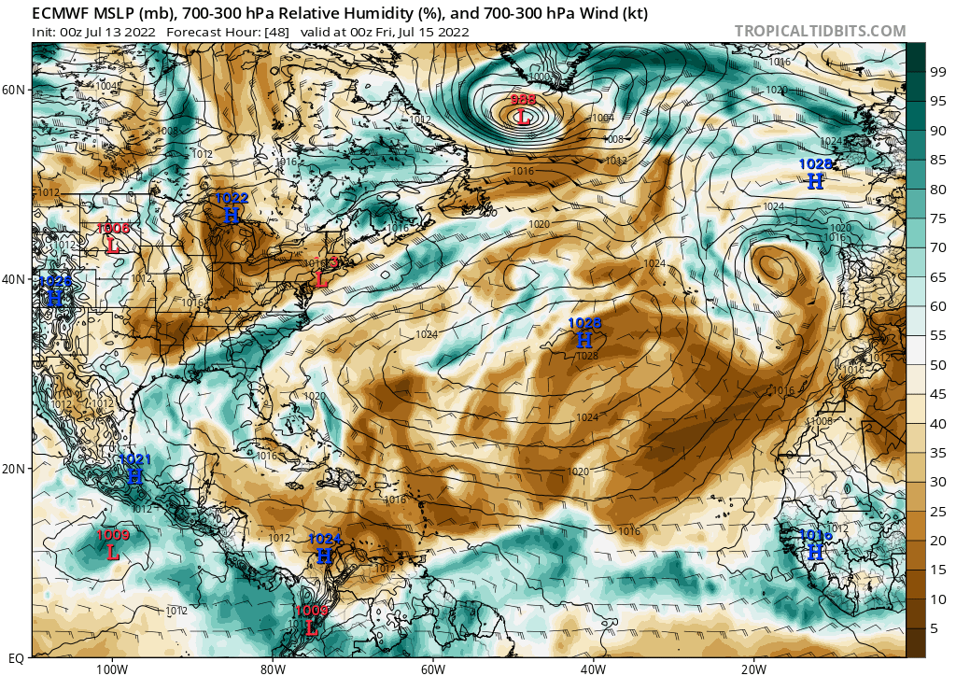
Forecast – day 2
(July 28, 2021)
Mid-level RH, Geopotential Height, Winds

Slide 12
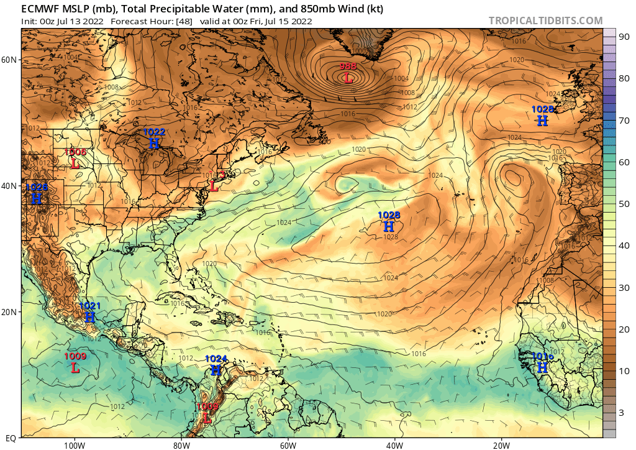
Forecast – day 2
(July 28, 2021)
TPW, OLR

Slide 13
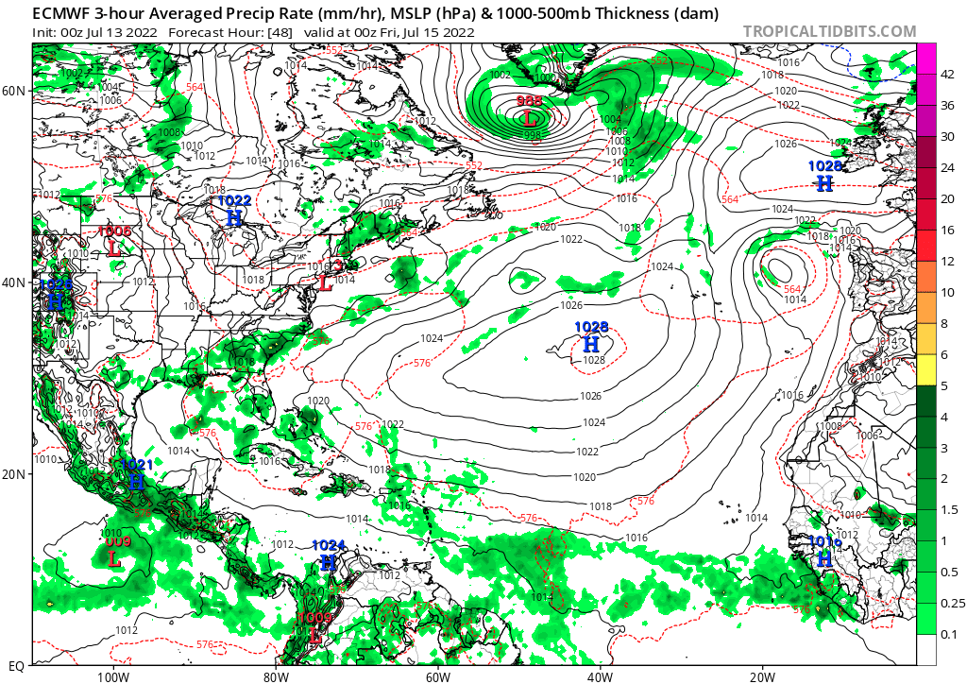
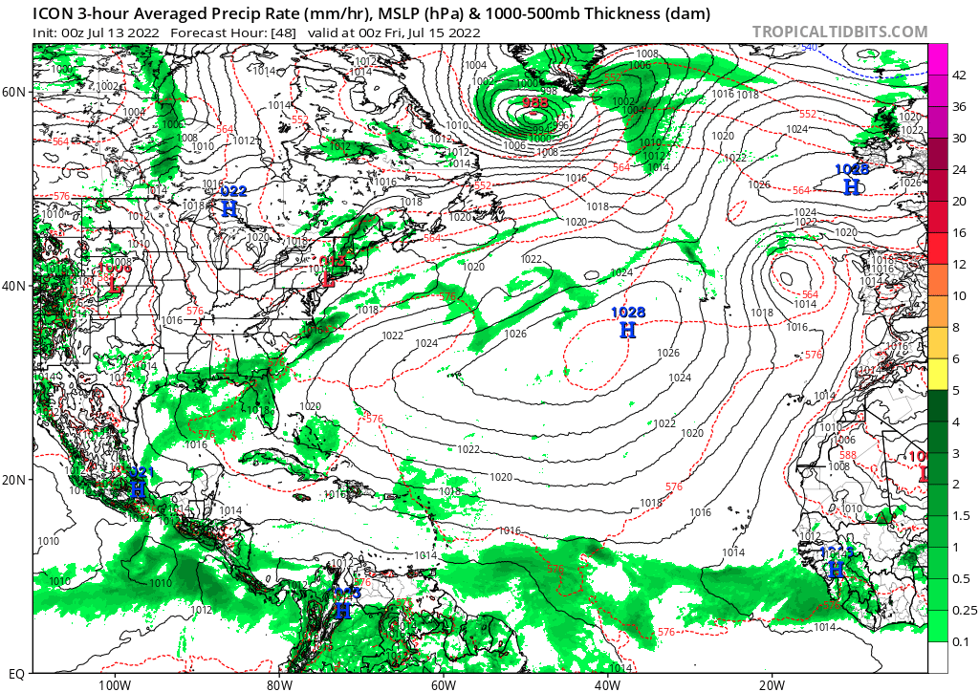
Forecast – day 2
(July 28, 2021)
10m Winds, Rain – ECMWF
10m Winds, Rain – ICON

Slide 14
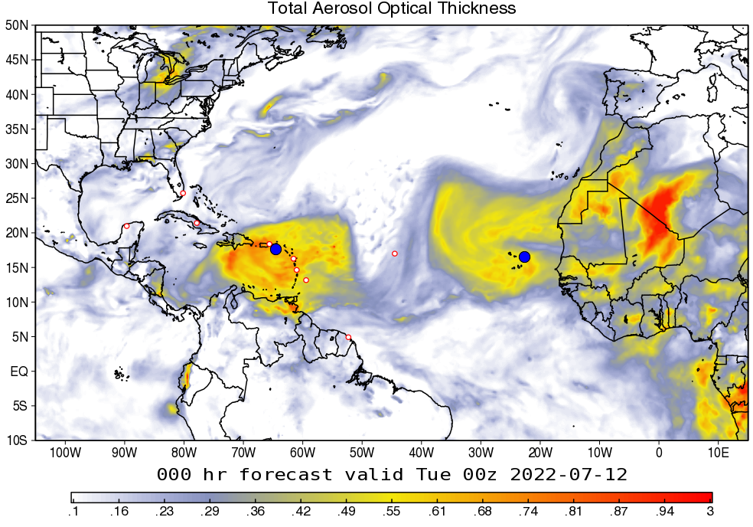
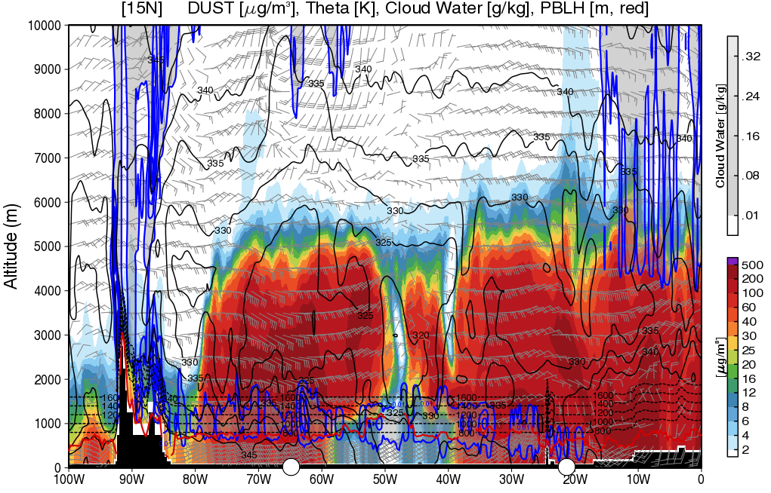
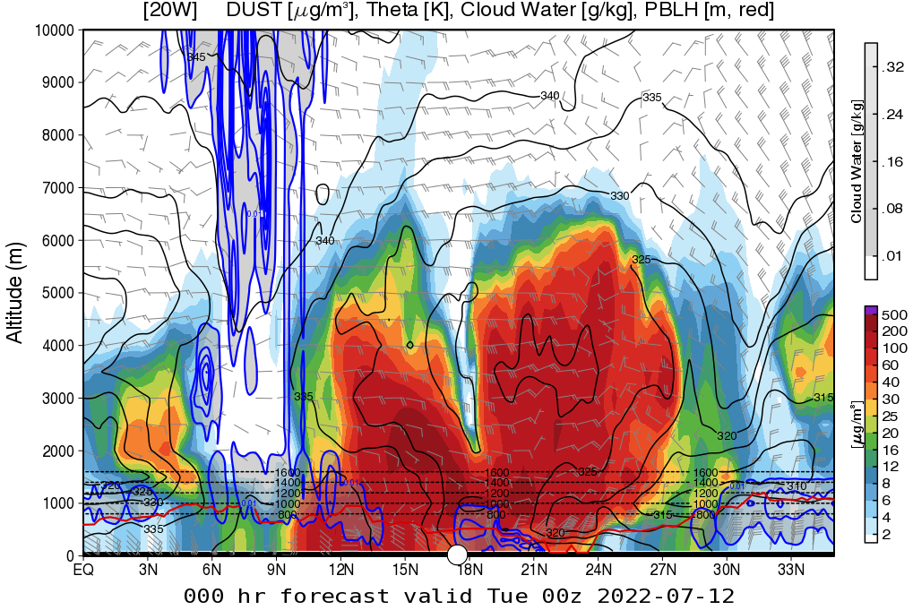
Dust and Aerosols - Current
(July 27, 2021)
Total AOT - GEOS
Dust cross-section at 15°N
Dust AOT - GEOS
Dust cross-section at 20°W

Slide 15
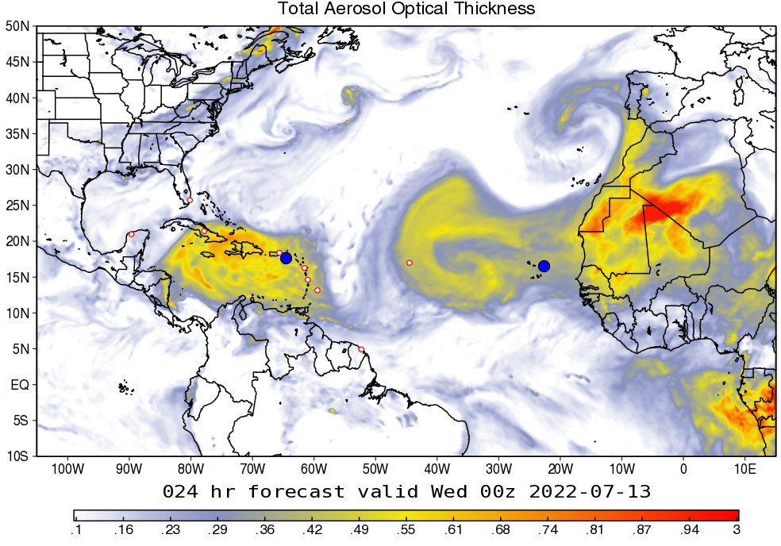
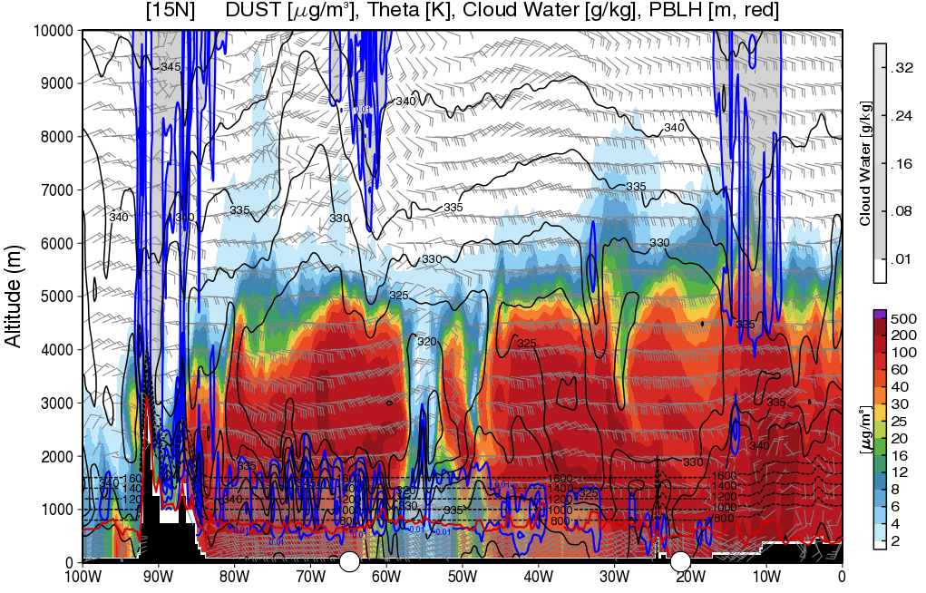
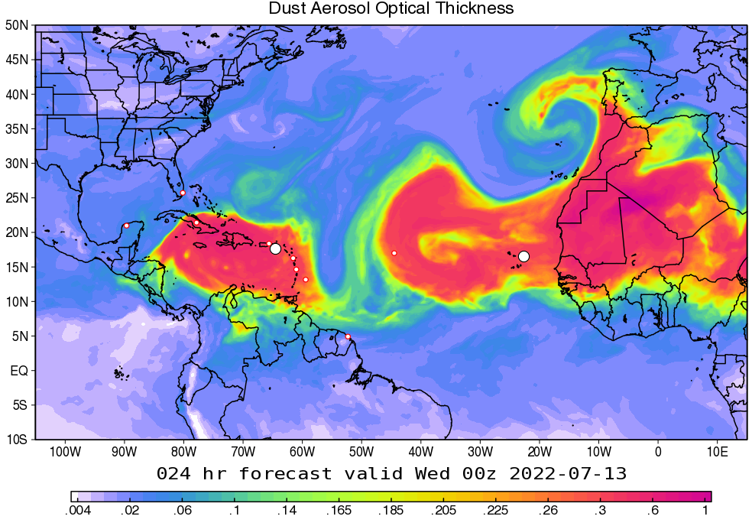
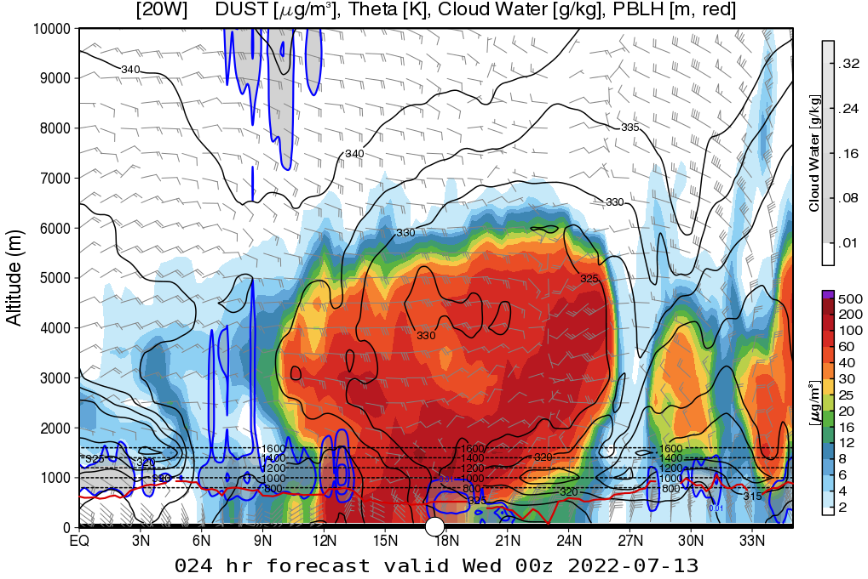
Dust and Aerosols - Day 1
(July 28, 2021)
Total AOT - GEOS
Dust cross-section at 15°N
Dust AOT - GEOS
Dust cross-section at 20°W

Slide 16
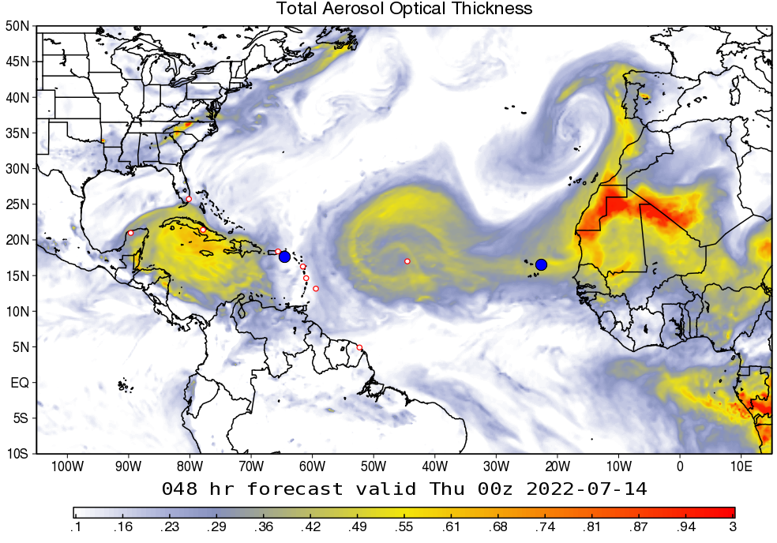
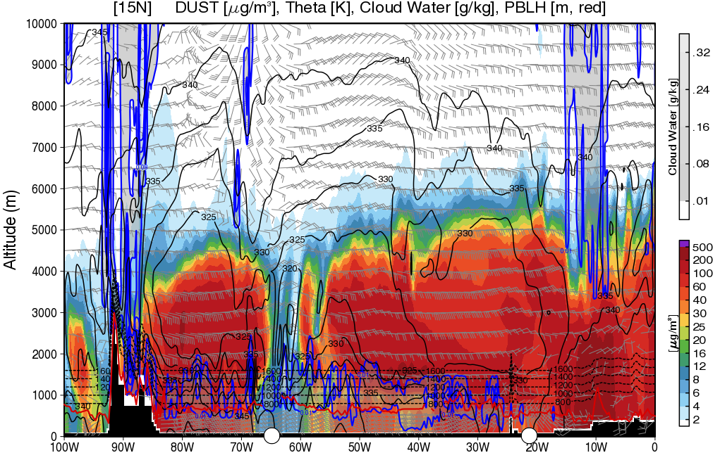
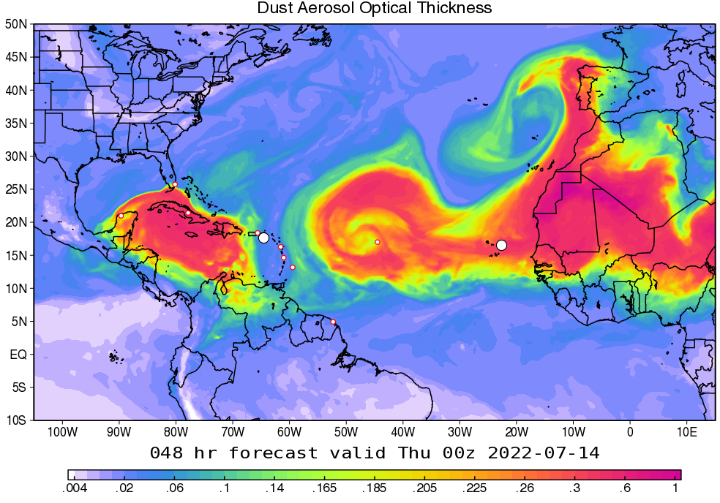
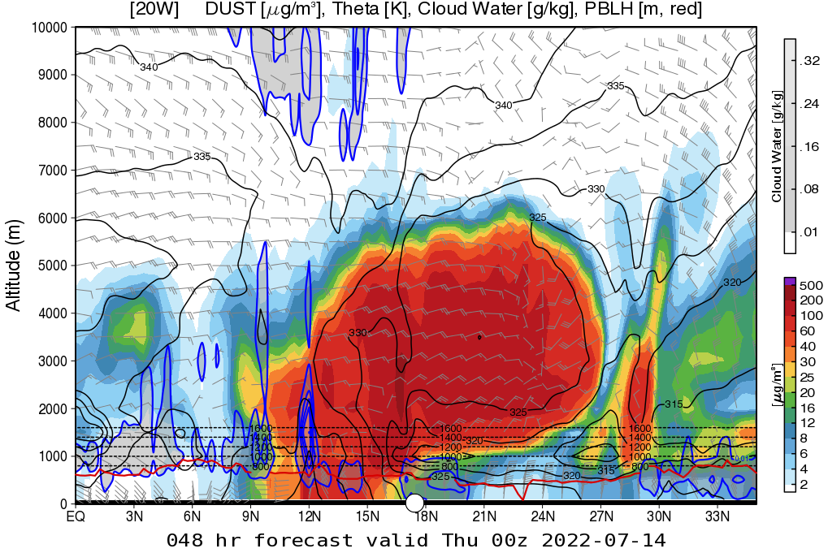
Dust and Aerosols - Day 2
(July 29, 2021)
Total AOT - GEOS
Dust cross-section at 15°N
Dust AOT - GEOS
Dust cross-section at 20°W
AEW

Slide 17
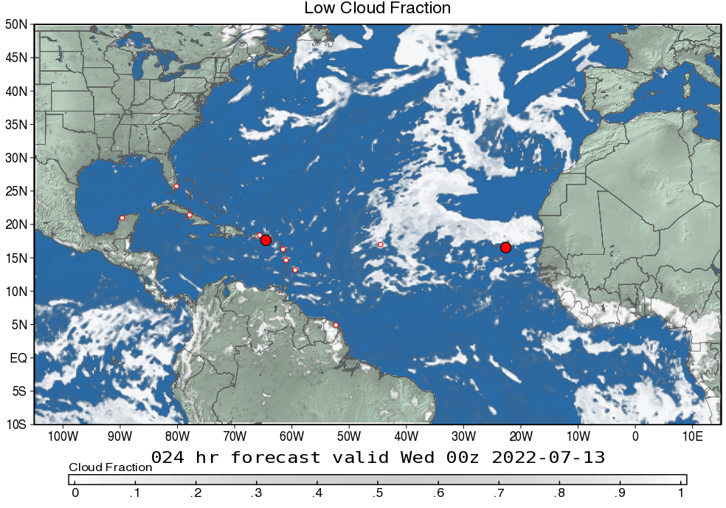
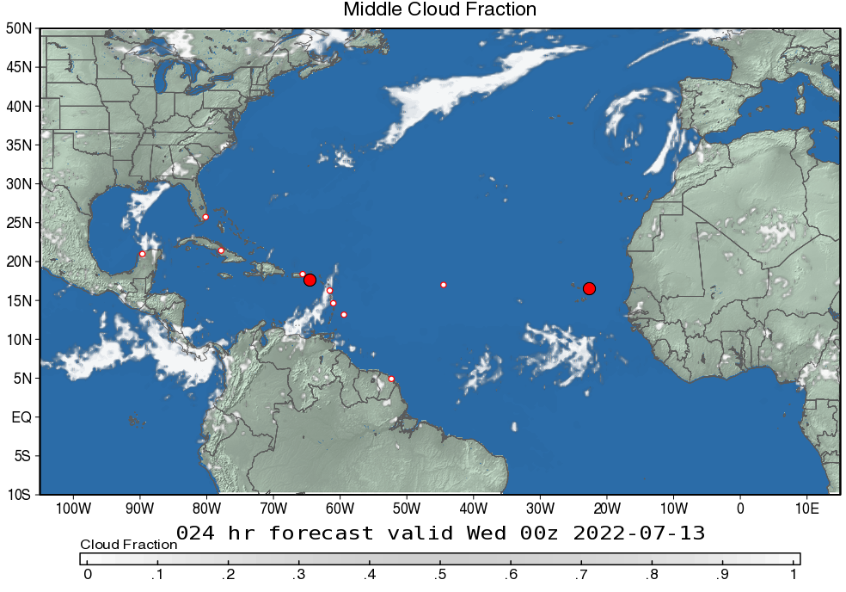
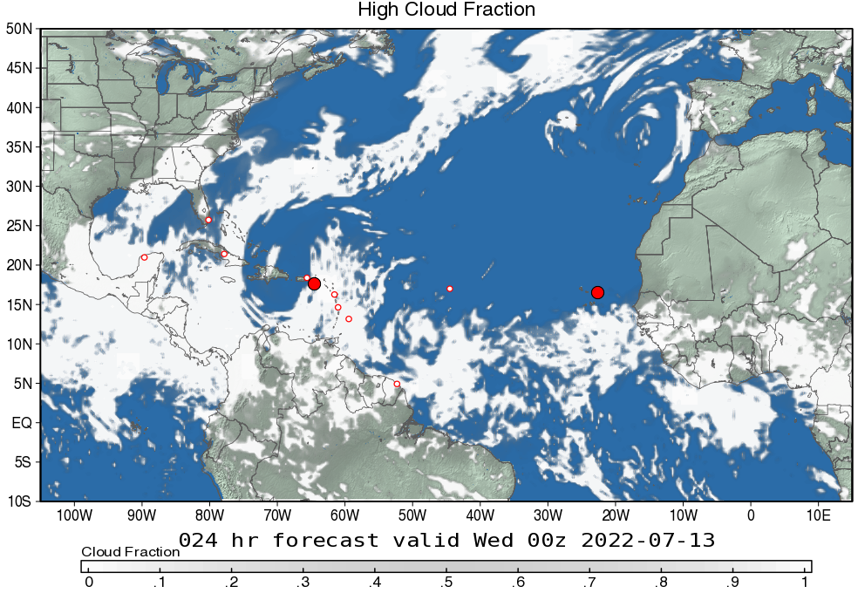
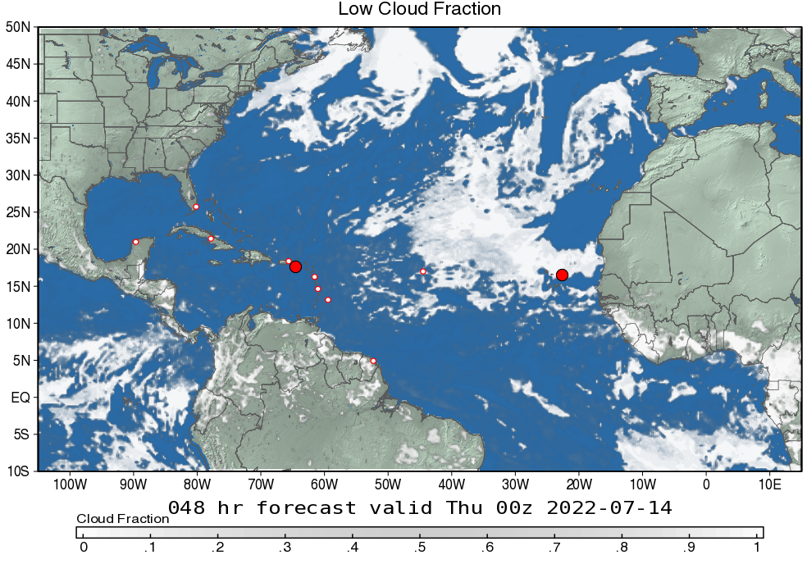
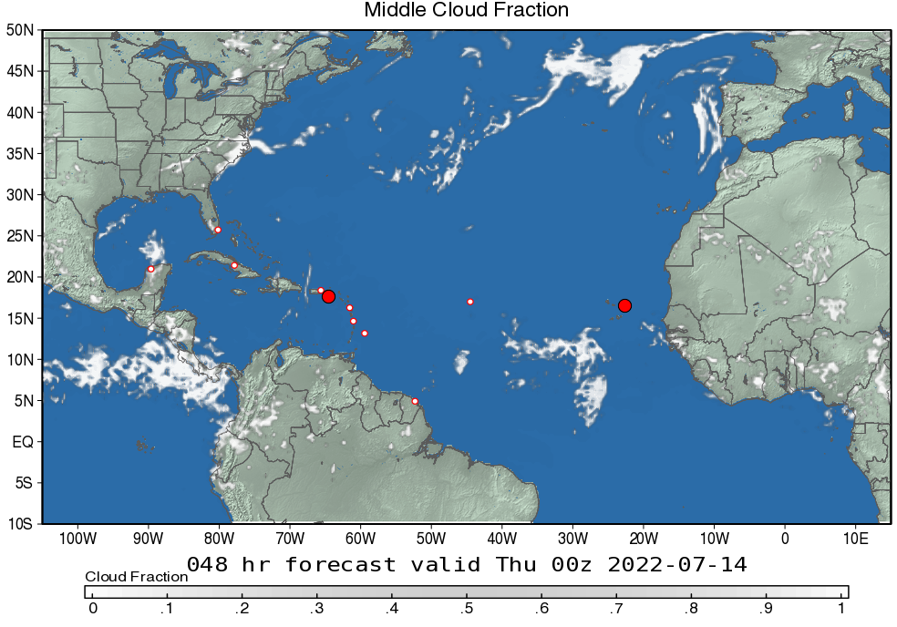
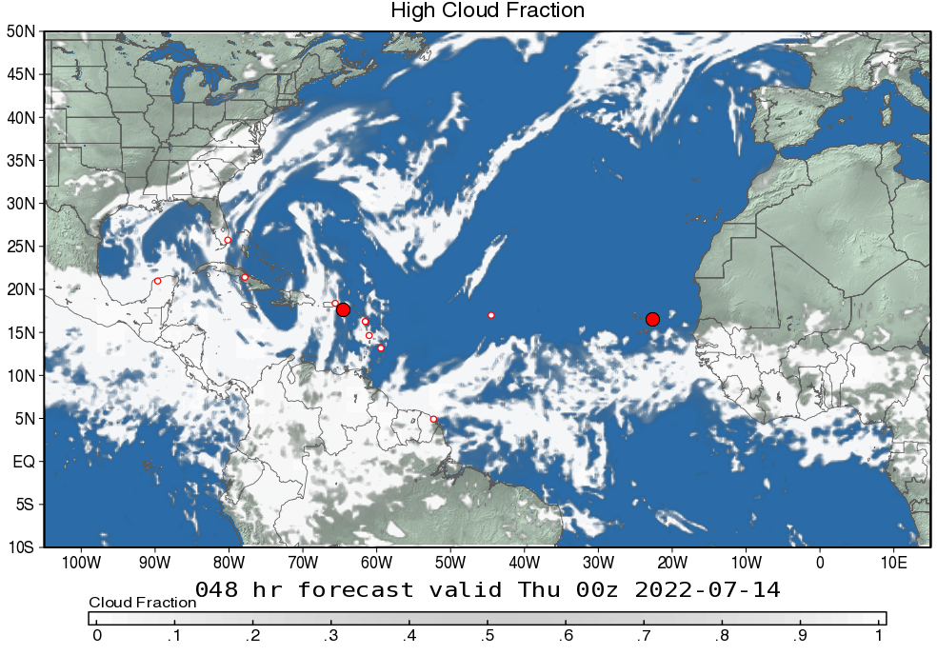
Cloud Fraction – days 1 & 2
(July 28 & 29, 2021)
Below 700 mb
400 - 700 mb
Above 400 mb
Day 1
Low cloud fraction
Middle cloud fraction
High cloud fraction
Day 2
Low cloud fraction
Middle cloud fraction
High cloud fraction

Slide 18
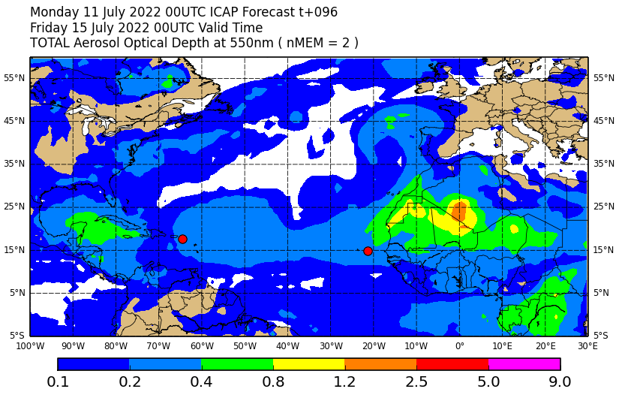
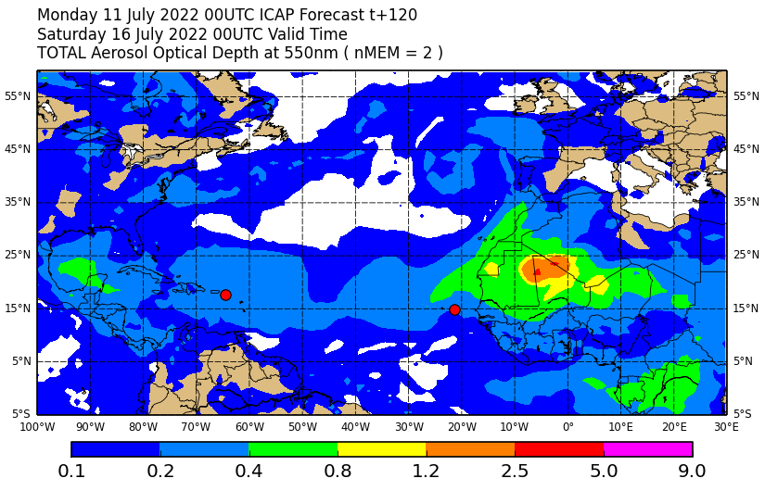
Dust and Aerosols Outlook – Days 3 & 5
(July 29 & 31, 2021)
Ensemble mean total AOT (day 3)
Ensemble mean total AOT (day 5)

Slide 19
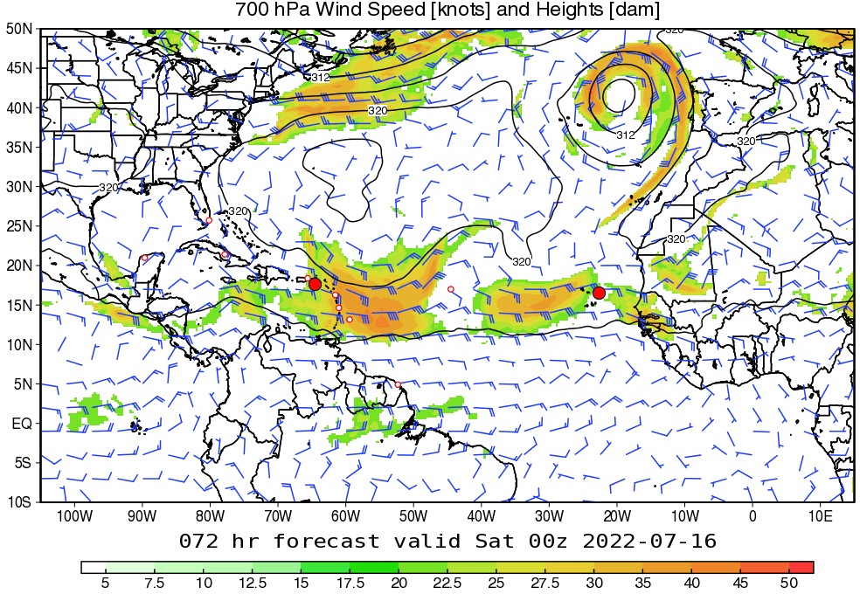
Dynamical Outlook – Days 3-5
(July 30- Aug. 1, 2021)
700mb Winds and Geopotential Height - GEOS

Slide 20
Summary
ITCZ continues weakening. Dust arrives St. Croix. SAL continues moving westward.
Dust leaves St. Croix. AEW propagate westward. Dry and dusty air rolls into the west of AEW.
AEW continues propagating westward. Dry air intrudes deeper into the moist area.
New AEW propagates offshore from West Africa. African easterly jet is ahead of the inversed trough.

Slide 21
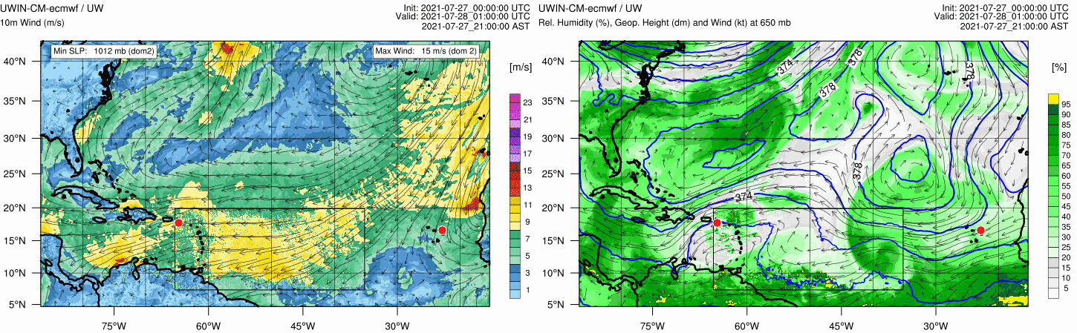
Forecast – day 1
(July 28, 2021)
10m Winds
650mb RH, Geopotential Height, Winds
AEW
Dry air intrudes into the west of AEW.

Slide 22
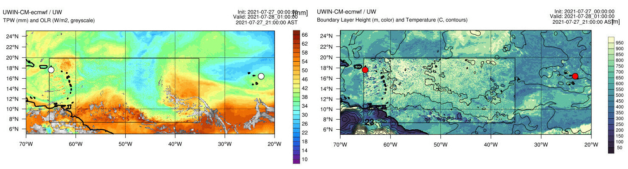
Forecast – day 1
(July 28, 2021)
TPW, OLR
PBL Height and Temperature
AEW
AEW propagates westward, but no significant weather occurs.
Aeolus overpass occurs around 50W (7/28 0500 AST)

Slide 23
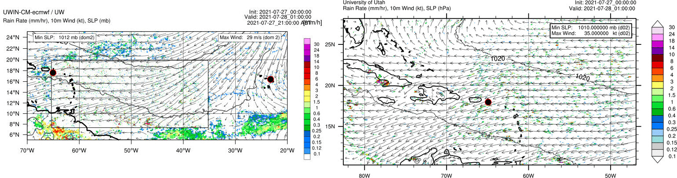
Forecast – day 1
(July 28, 2021)
10m Winds, MSLP, Rain – UWIN-CM
10m Winds, MSLP, Rain – U. of Utah WRF

Slide 24
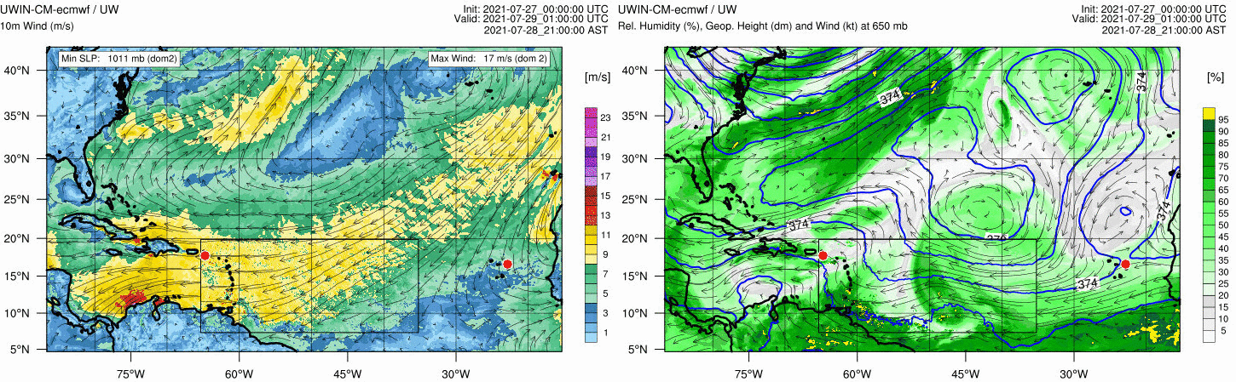
Forecast – day 2
(July 29, 2021)
10m Winds
650mb RH, Geopotential Height, Winds
AEW
Dry air rolls in deeper into the moist area.

Slide 25
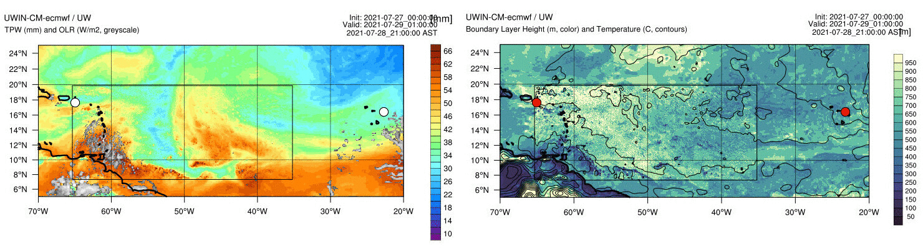
Forecast – day 2
(July 29, 2021)
TPW, OLR
PBL Height and Temperature
AEW
AEW continues weakening; no sign of strong convective activity.

Slide 26
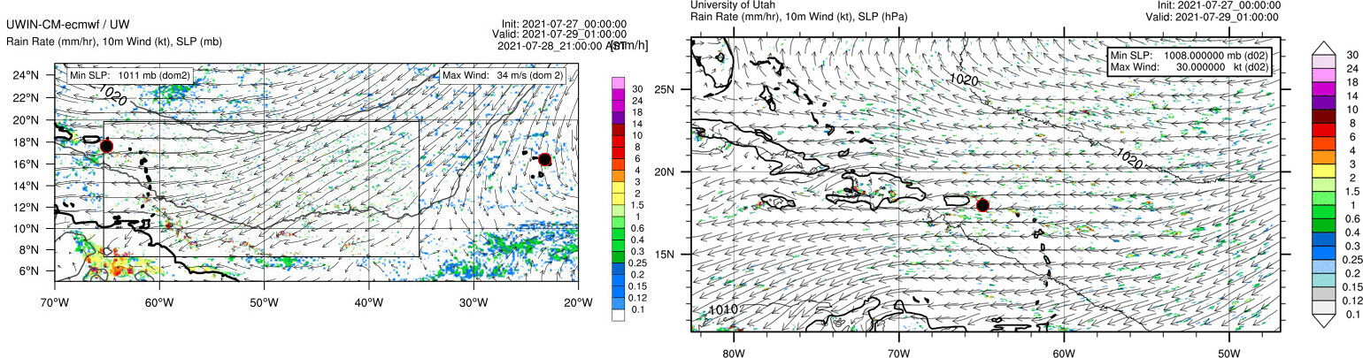
Forecast – day 2
(July 29, 2021)
10m Winds, MSLP, Rain – UWIN-CM
10m Winds, MSLP, Rain – U. of Utah WRF

